Slide 1
Introduction to Model-View-ViewModel
Karl Shifflett
Program Manager, Microsoft patterns & practices

Slide 2
What is MVVM?
UI design pattern
A way to think about applications

Slide 3
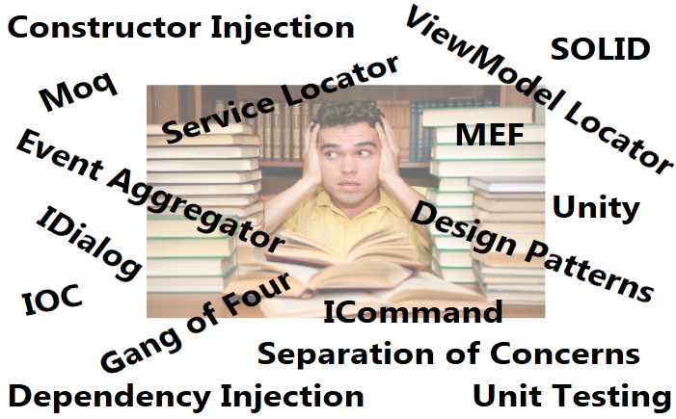
Breath, crawl, toddle, walk, run

Slide 4

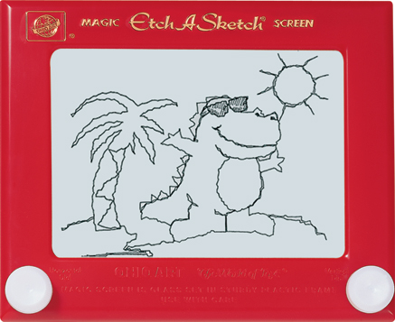



Goal
Sessions Monday & Tuesday
Current thinking
New You

Slide 5
Motivation for MVVM
Natural pattern for XAML platforms
Separation of concerns
Testability
Maintenance
Evolving the application
Loosely coupled
Designer-Developer workflow
Reuse on other platforms (Silverlight)

Slide 6
The MVVM Pattern is SIMPLE
View
ViewModel
Model

Slide 7
View
View
ViewModel
Model
User interface
Window, UserControl, Page or DataTemplate
DataContext is the ViewModel
Little or no code-behind
Updated via data bindings
Command Sources
Behaviors

Slide 8
ViewModel
View
ViewModel
Model
Abstraction of the View
Adapts Model to View
Maintains State
Exposes properties the View binds to (data and ICommand properties)
Exposes methods View behaviors can call
Loose coupling and testability is the high order bit
Stay away from calling singletons
Stay away from creating up dependencies
Stay away from launching dialogs directly
If not using TDD or BDD, test your ViewModels early on

Slide 9
Avoid Tight Coupling - Example
A ViewModel needs to display a message to the user.
Should the ViewModel use MessageBox.Show()?
Is this a good practice?
Is this testable?
Is the code easy to evolve over time?
For example, Windows 10 comes out with a new cooler message box with a different API.
Remember when the Vista TaskDialog came out?
ViewModel
Uses
MessageBox Class

Slide 10
Model
View
ViewModel
Model
Your domain
Data objects
DTO, POCO
Generated data model
Generated proxy model
Service Layer
Repositories
Business objects

Slide 11
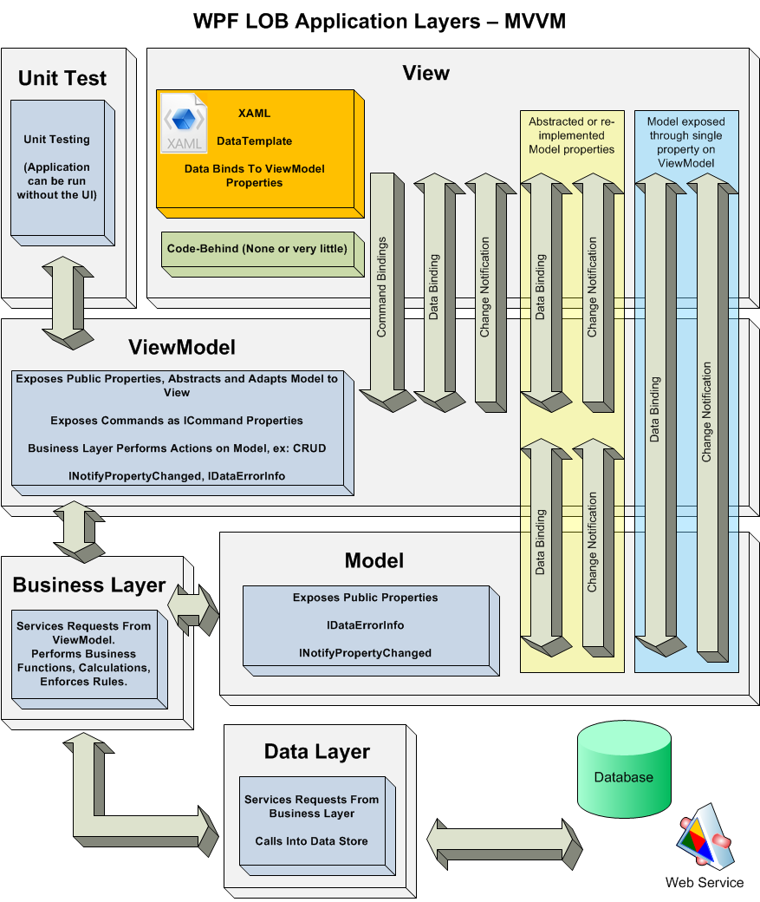

Slide 12
Relationship & Creation
View
View
View
View
View
View
ViewModel
ViewModel
ViewModel
ViewModel
ViewModel
Model
View First
View creates the ViewModel (in XAML or code-behind)
View has the ViewModel injected (property or constructor)
ViewModel First
ViewModel creates View (usually injected), wires itself to the View
Resource system looks up DataTemplate (View)
Other
IOC container can create View and ViewModel together
Rob Eisenberg Caliburn.Micro Framework
Presenter creates View, connects ViewModel

Slide 13

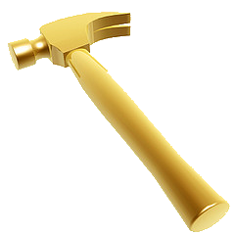
Wiring View and ViewModel Should be Natural
View
View
View
View
View
View
ViewModel
ViewModel
ViewModel
ViewModel
ViewModel
Model

Slide 14
Demo
Wiring up View and ViewModel
Wpf.Mvvm

Slide 15
Thinking in MVVM
To change the View, set a ViewModel property
To disable a button; bind to property
To change ViewState; bind to property
To start an animation; bind to property
To show validation errors; bind to property
For View to execute code
View CommandSources bind to ICommand properties
View behaviors bind to ICommand or invoke methods

Slide 16
Developer-Designer Workflow
Designer uses Blend
Designer can work in isolation
Does not need to touch code file
Can bind to ViewModel properties
Can create design-time sample data
Can create cool animations
Uses Behaviors to fill gaps in XAML capabilities

Slide 17
Keeping it Simple
Review
View is in XAML
View holds a reference to the ViewModel (not always)
View Binds to ViewModel
View uses Commands to invoke methods on the ViewModel
View uses Behaviors to invoke methods on the ViewModel
ViewModel holds a reference to the Model
My General Practices
View can bind to Model (for static data, e.g. list of states)
ViewModel avoids duplication of Model unless warranted
Very seldom does the ViewModel need view-related logic, code-behind is OK for this
View first approach

Slide 18
Closing – MVVM
It is natural pattern for XAML platforms
Provides separation of concerns
Increases application testability
Enables the developer-designer workflow

Slide 19
Contact
Twitter: @kdawg02
Blogs
http://karlshifflett.wordpress.com/
http://blogs.msdn.com/b/kashiffl/
http://blogs.msdn.com/b/wpfsldesigner/
Links
http://compositewpf.codeplex.com/
http://msdn.microsoft.com/en-us/practices/default.aspx
MVVM Tutorials
http://karlshifflett.wordpress.com/2010/05/09/stuff-wpf-line-of-business-using-mvvm-video-tutorial/
http://karlshifflett.wordpress.com/2010/11/07/in-the-box-ndash-mvvm-training/

Slide 20


